Slide 1


SATs Information Meeting
Year 6 SATs
12th – 15th May 2025

Slide 2
Meeting Aims:
To inform you of:
what SATs are and how they have been previously structured
how we will prepare for SATs in school
how you can help to support your child at home

Slide 3
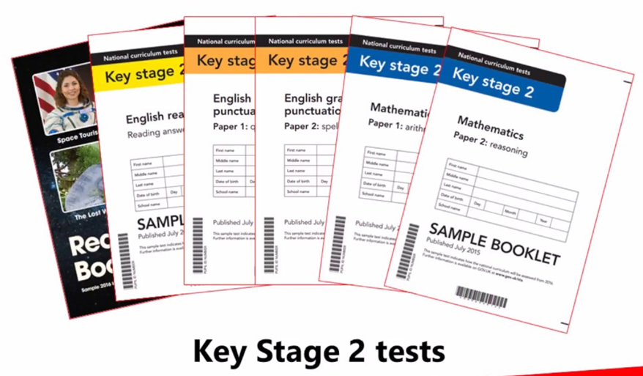
What are the KS2 SATs?
SATs means Standard Attainment Tests.
They are marked externally.
Results are sent to school, accepted and given verbally to children. These are usually sent home with annual reports.

Slide 4
Why do we have SATs?
National requirement
Designed to assess children’s knowledge and understanding of the Key Stage 2 programmes of study. They provide a snapshot of a child’s attainment at the end of the Key Stage.
Secondary school information and baseline
Notes:
National requirement.
Designed to assess children’s knowledge and understanding of the Key Stage 2 programmes of study. They provide a snapshot of a child’s attainment at the end of the Key Stage.
Comparison - indicate schools attainment in line with National Standards – although it is important to note that the SATs information will not be used for comparison against other schools for this academic year.
Secondary school information and baseline.

Slide 5
SATs Week Structure:
Published 2025 timetable:
Monday 12th May | Tuesday 13th May | Wednesday 14t^{h} May | Thursday 15th May
Grammar and Punctuation 50 marks 45 mins Spelling 20 marks Approx. 20 mins | Reading Test 50 marks 1 hour | Maths - Arithmetic 40 marks 30 mins Maths - Reasoning Paper 2 35 marks 40 mins | Maths - Reasoning Paper 3 35 marks 40 mins

Slide 6
How will SATs week be organised?
Usual start and finish time – tests timetabled during school hours
Desks arranged individually and displays/prompts hidden
Children registered and have a verbal revision session
Test papers brought to classrooms
Papers opened and instructions given
Two or more staff act as invigilators
Readers available when requested in the Maths and SPaG papers
Additional support provision provided on an individual basis (SEND Access Arrangements)
Silence during tests
Fun activities/learning

Slide 7

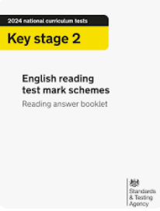
Structure of the reading assessment:
The Reading assessment lasts 1 hour.
The children in previous years have received a ‘Reading Booklet’ containing three texts and a ‘Reading answer booklet’ containing three sections of questions about the key texts.

Slide 8
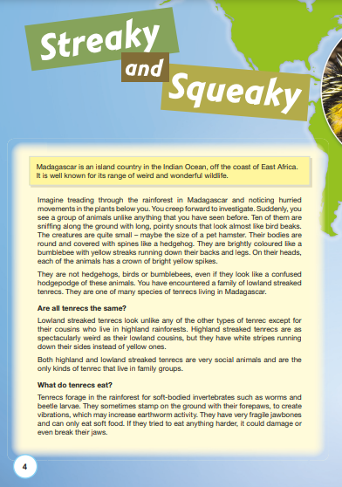
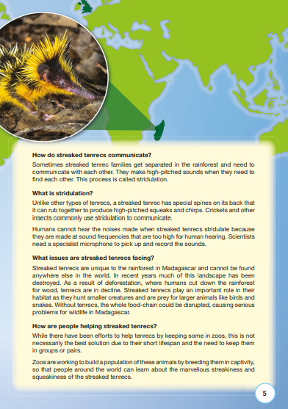

Slide 9
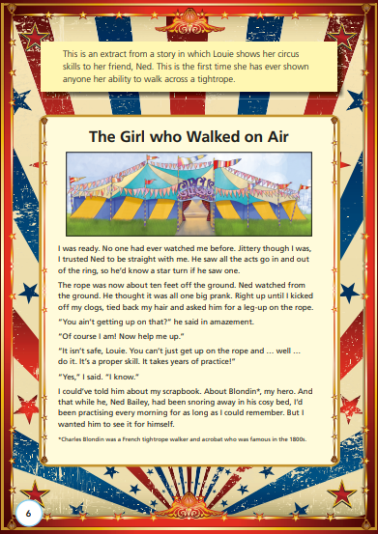
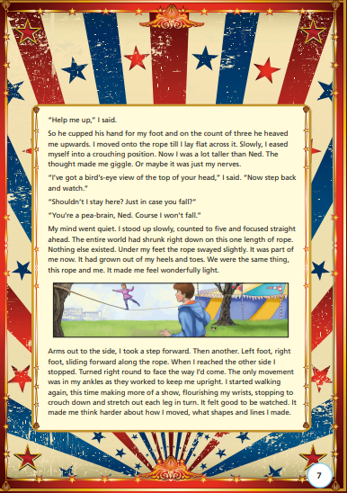

Slide 10
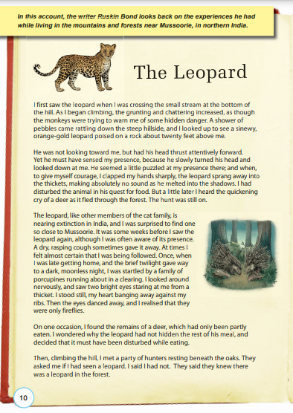
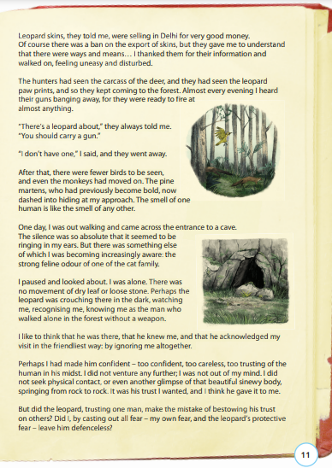

Slide 11
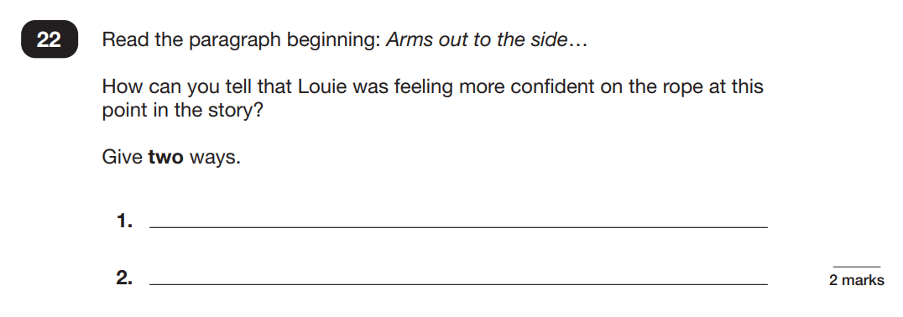
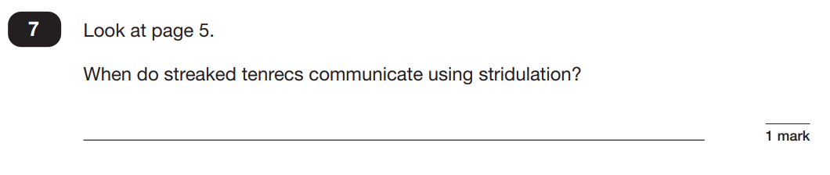
Structure of the reading assessment:

Slide 12
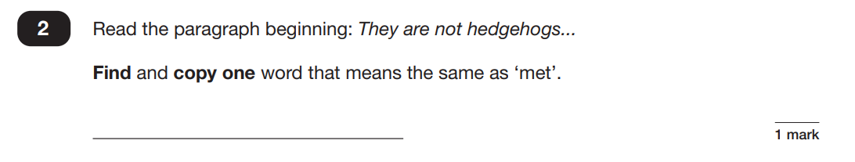
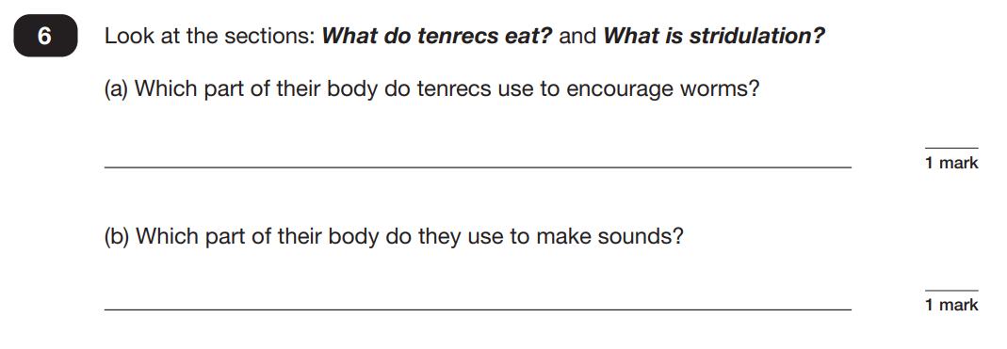
Structure of the reading assessment:

Slide 13
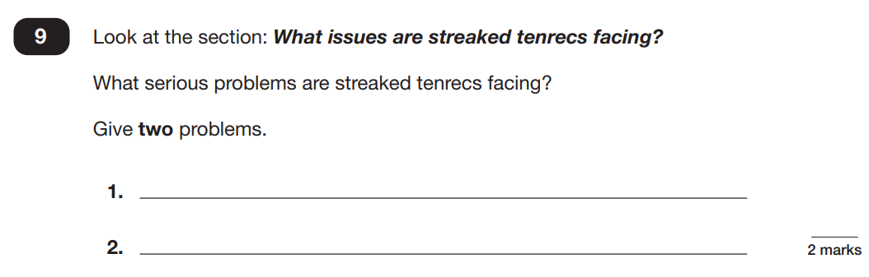
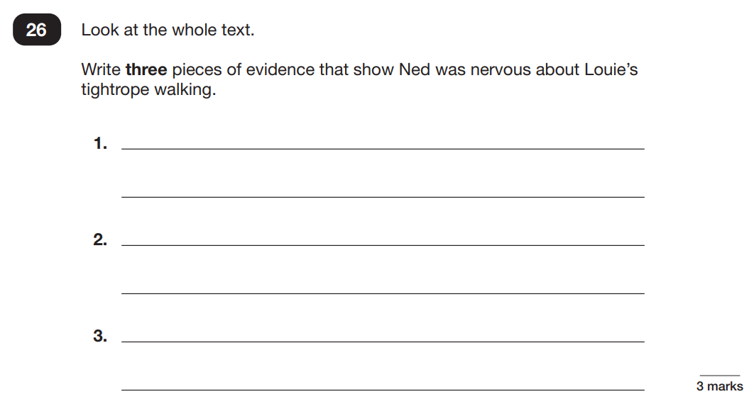
Structure of the reading assessment:

Slide 14
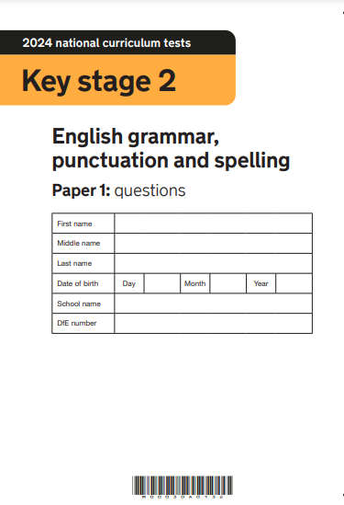
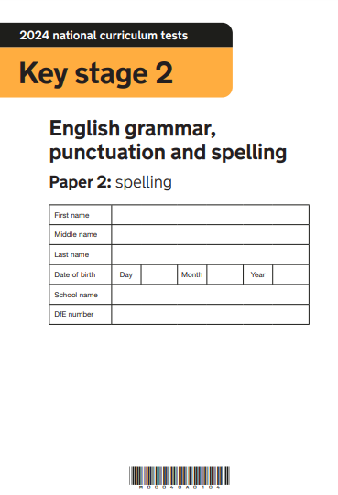
Structure of the Spelling, Punctuation and Grammar assessment:
The SPaG assessment is usually split into two sections.
  Section 1 has previously been based on questions about grammar, punctuation and spelling which lasted 45 minutes.
  Section 2 has previously contained a 20 word spelling test.

Slide 15
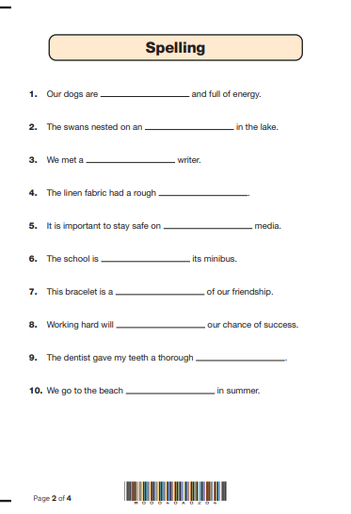
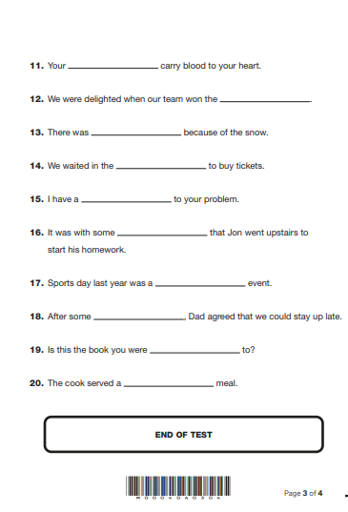

Slide 16
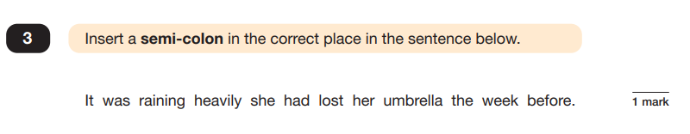
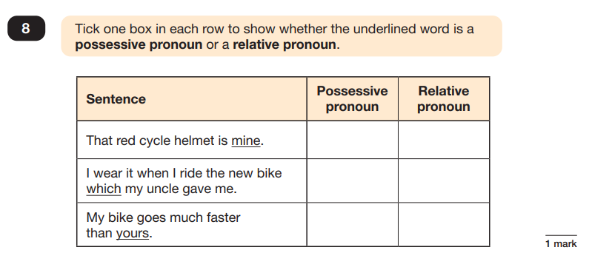
Structure of the Spelling, Punctuation and Grammar assessment:

Slide 17
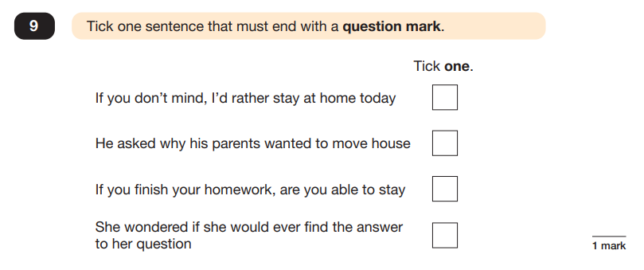
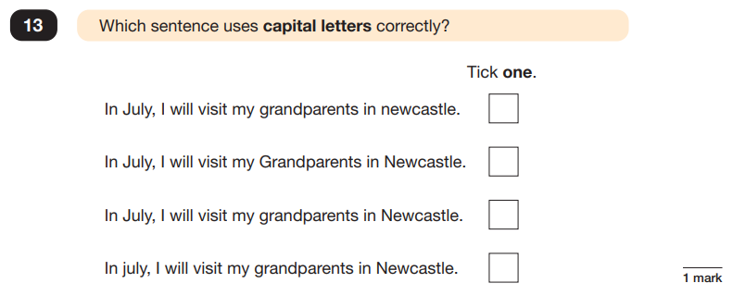
Structure of the Spelling, Punctuation and Grammar assessment:

Slide 18
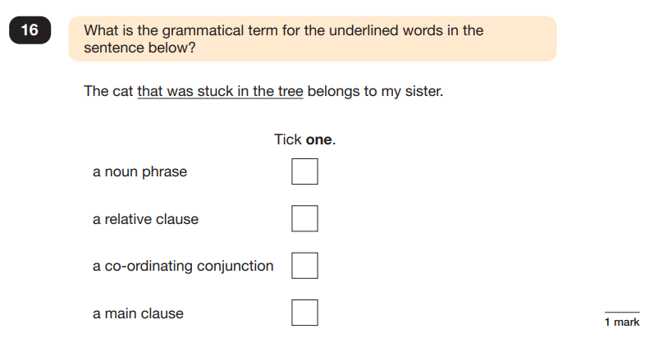
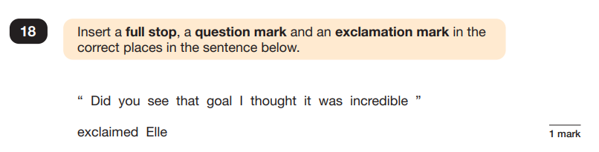
Structure of the Spelling, Punctuation and Grammar assessment:

Slide 19
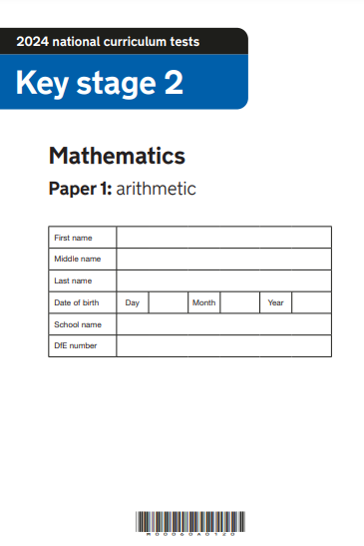
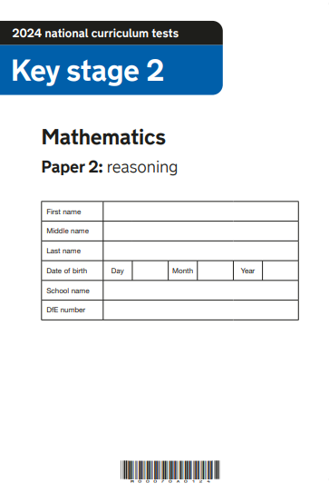
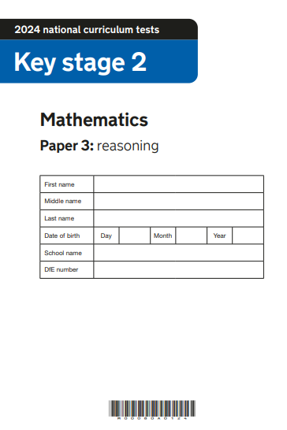
Structure of the Mathematics assessments:
The mathematics assessments are split into three papers.
  Paper 1 - arithmetic (30 minutes)
  Papers 2 and 3 - reasoning (40 minutes)

Slide 20
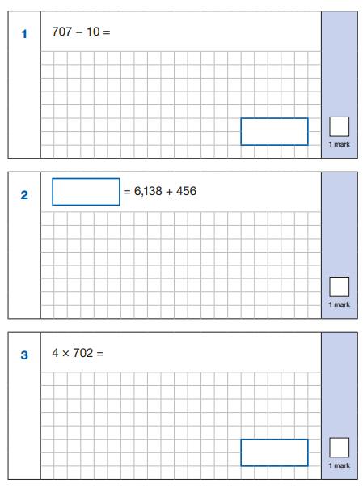
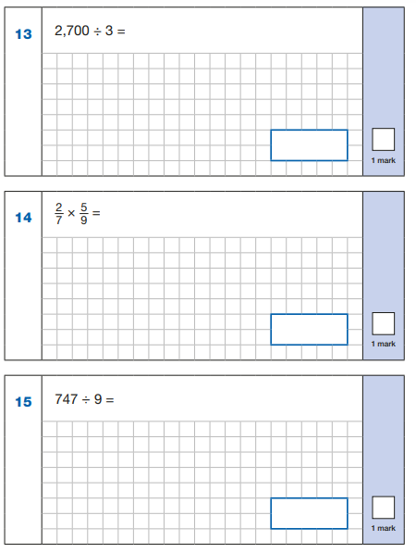
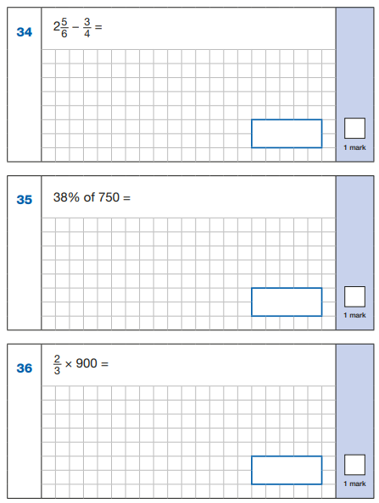
Structure of the Mathematics assessments:

Slide 21
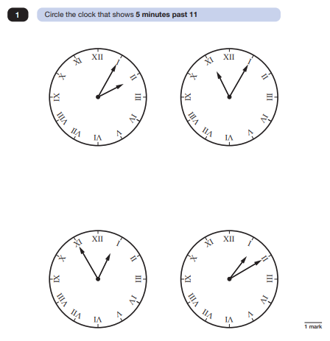
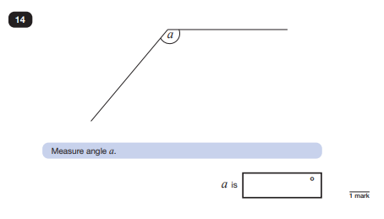
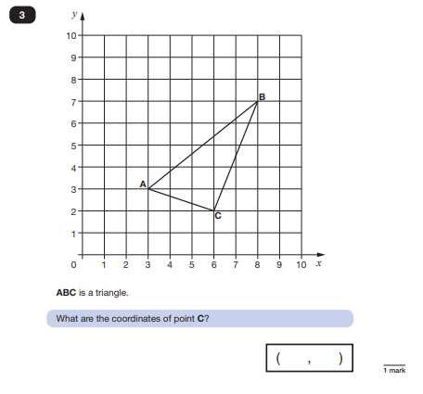
Structure of the Mathematics assessments:

Slide 22
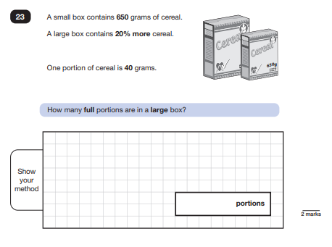
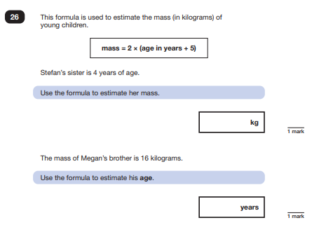
Structure of the Mathematics assessments:

Slide 23
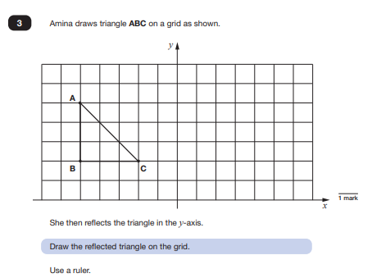
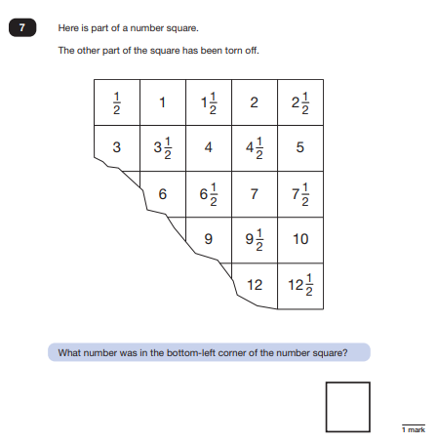
Structure of the Mathematics assessments:

Slide 24
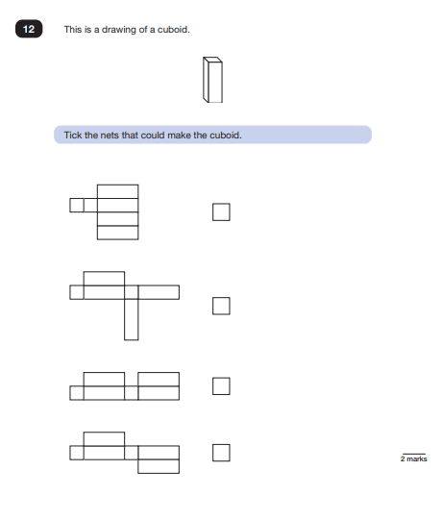
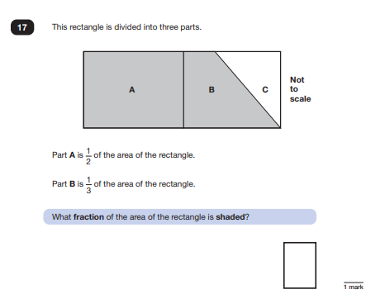
Structure of the Mathematics assessments:

Slide 25
How will we prepare the children for their SATs?
Children have already been preparing throughout their time in school.
We ensure that our curriculum is organised to not only cover Year 6 objectives but also revise key information from across KS2 and build on foundations of Reception and KS1.
The children complete formal assessments within each year group as part of our ongoing assessment.
Throughout Year 6, the children receive intervention and booster group support where a need is identified.
Home learning activities are planned to consolidate learning from class.
Maths and SPaG Revision Clubs are run after school during the spring term by invitation only.

Slide 26
Access Arrangements
Children can be assessed for additional support which will allow them to access the assessments. This could include:
  Reader (1:1 or in-class)
  Time (applied for with evidence)
  Scribe or transcribe
  Prompter
  Movement breaks

Slide 27
Supporting Reading:
To support the children for the reading assessment it is important to:
  Read a range of texts regularly and for sustained periods of time (focus on speed, accuracy & fluency)
  Ask questions before, during and after reading with your child
  Discuss key vocabulary definitions and comprehension whilst reading
  Ensure that children complete any home learning or revision activities – ask class teachers for help if needed

Slide 28
Supporting Spelling, Punctuation and Grammar:
To support the children for the SPaG assessments it is important to:
  Learn weekly spellings and address any words that you notice are commonly misspelt by your child
  Continue to read regularly as books model grammar and punctuation
  Ensure that children complete any home learning or revision activities – let us know if any help required
  Support your child in making sure that correct punctuation is used when writing at home

Slide 29
Supporting Maths:
To support the children for the mathematics assessments it is important to:
  Spend time on TTRockstars to build up fluency in multiplication tables
  Play other games to recall key facts eg. %/fraction/decimal conversions and number bonds (speed and accuracy
  Discuss key learning (including written strategies) from school with your child
  Ensure that children complete any home learning or revision activities

Slide 30
Ongoing support:
Prior to SATS Week…
Attendance and punctuality
Balance of importance
Encourage positive approach to school support eg. IG and revision club
Support home learning (reading, spelling, mental fluency/TTRS & other tasks)
Communicate with us if any concerns (while they are small!)
During SATs Week…
Punctual
Early nights and well rested
Fed and watered!
Most importantly…
no pressure!

Slide 31
Thank you for listening
Any questions?
Please use this time, if you wish, to have a look at some of the past papers but do not take these home with you!

