Slide 1


Welcome to…
YEAR 6
September 2025
Notes:
Good afternoon and welcome to ‘Meet the Teacher’ with Year 6.
Thank you for joining us. During this meeting, we hope to inform you of key information, learning and upcoming events during this academic year.
Know there are still considerations to be made but we are SO excited to have the children back in school!
Our number 1 priority is settling the children in, reassuring them and then getting them back on track with their learning (in that order!) – need to work together!

Slide 2
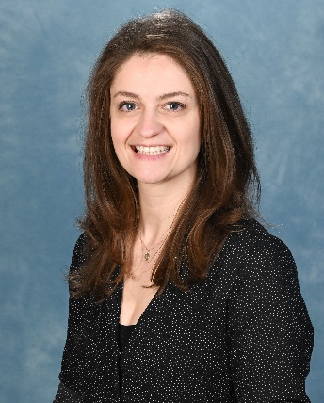
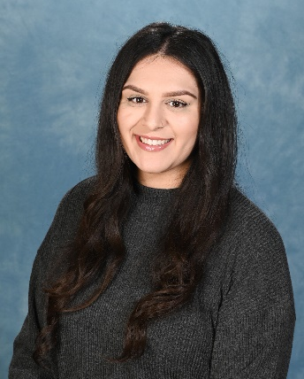
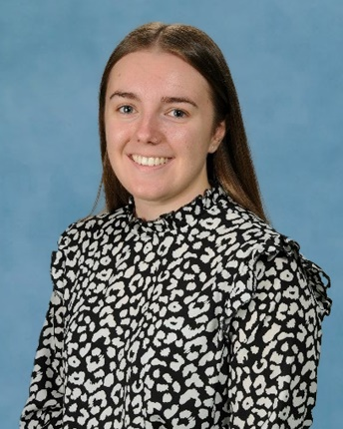
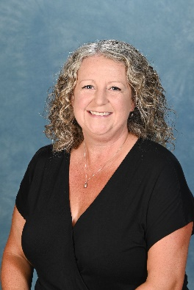
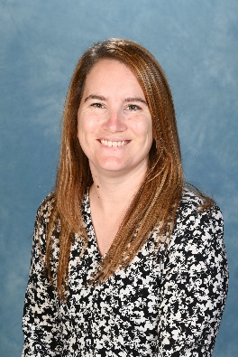
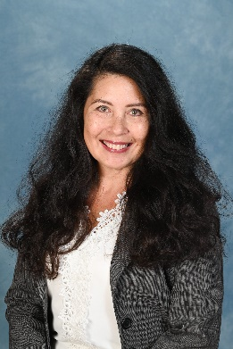
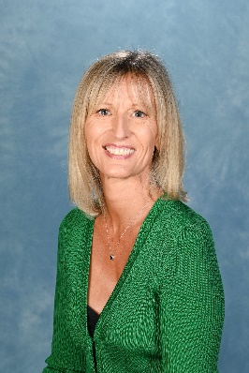
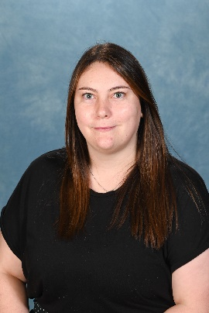
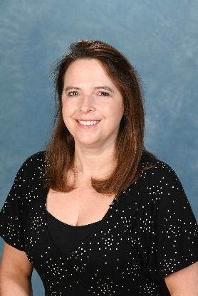
Meet the Year 6 Team…
6HC – Miss Creelie
Team Leader
6ZN – Mrs Nasir
Class Teacher
6CB – Miss Bremner Class Teacher
Learning Support Team…
Mrs Eyles
HLTA
Miss Baker
LSA
Mrs Lewis
LSA
Mrs Warren
LSA
Miss Gibbard
LSA
Mrs Brignall
Teaching Support
Notes:
HC

Slide 3
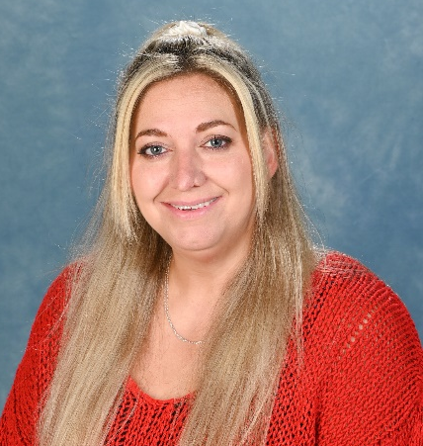
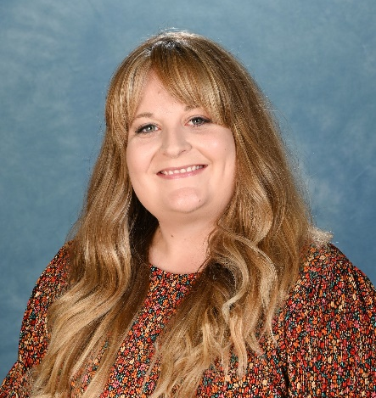
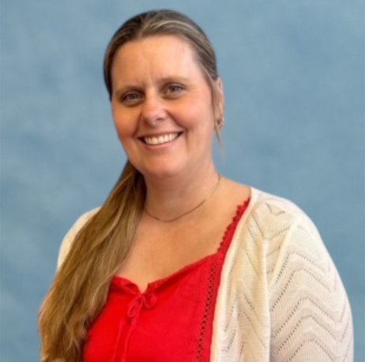
Extended Team…
Miss Parsons
Federation SENCO
Mrs Kirby
FSW
Mrs Barratt
ELSA
Notes:
HC

Slide 4
A few highlights of the year to come…
Spring
Fantastic Finish! (08.01.26)
Location, Location, Location
Local Area Walks
Poetry Slam
World Book Day
Residential to Condover Hall (16.03.26-20.03.26)
The Monarchy topic
Potted Sports
6HC Radio show
Summer
Mountains, volcanoes, earthquakes and coasts topic
SATs Week (11.05.26-14.05.26)
Year 6 Production!
Year 6 Leavers Assembly
Year 6 BBQ
6ZN Radio Show
Secondary School Taster Days
Ration cooking and pulley systems DT project
Winchester Military Museums (13.10.25 & 14.10.25)
6CB Radio Show
Bikeability
World War II Creative Day (05.12.25)
- Christmas fun!
Autumn
Remember to check Miss Redman’s weekly newsletter for upcoming dates and events!
Notes:
Think about topics and year group highlights
Focus on ENJOY and ACHIEVE!
ZN

Slide 5

Exciting opportunities and responsibilities …
School Councillors
Eco Committee Representatives
Team Captains
Peer Mediators
JRSOs
Junior Librarians
Digital Leaders
Radio Leaders
Lunchtime Green Team
Class Monitors
Responsibility Assembly:
9th September 2025
Applications Deadline:
22nd September 2025
Appointments:
26th September 2025
Notes:
Whatever is appropriate for your year group…
CB

Slide 6
Attendance
The school day starts from 8.30am – into class at 8.40am (precious support time – reading, handwriting, home learning, mop up, pre teach!)
Learning time is maximised 9.00am lesson begins (before if everyone present!)
The Local Authority and Government expects the minimum satisfactory attendance to be at 95%
If absent, inform school (phone or email school.admin NOT ClassDojo!) ASAP but by 9.00am (safeguarding procedures – 3 contacts)
100% termly and annual certificates
90% attendance is the same as having a day off every two weeks.
Having 90% attendance over all of a child’s time in school is the same as missing a complete year!
Being 15 minutes late for school is the equivalent of missing two weeks of school each year!
Notes:
Attendance is really important for your child’s learning and social development (we have definitely learnt this!) - Appreciate circumstances continue to be challenging and safety will always come first, however, attendance is statutory and important for every child
For the class with highest attendance- they get a star on the chart
Most stars in a term – earn an afternoon in which the class choose a treat.
100% termly certificates will be awarded – obviously, if a child has to self-isolate this will not affect their chance for the certificate.
Miss Redman has responsibility to monitor and report to parents and governors termly (Ofsted indicator) –particularly important to support progress and well-being!
Expectation is a min of 95% (below is considered persistent absentee).
HC

Slide 7
Important reminders…
Termly Year Group Newsletters and Topic Webs
Mobile Phone Agreements
Uniform
Coats
P.E Kits
Termly Attainment Trackers and Key Targets
Walking Home Agreements
Free School Meals
Annual donation of £10
Healthy snacks and water
Notes:
Last Friday, you received the year group newsletter and this included important reminders, key information about the term ahead as well as a topic web so that you know our focusses for the term
In terms of assessment we are spending the first half term getting to know the children, planning a curriculum which builds on the their starting points and using assessment to address any gaps as well as move children on and challenge. At the first parents’ evening in November (hopefully face to face) you will receive your child’s attainment tracker with key targets which will inform you of your child’s attainment against the curriculum as well as what your child is on track to achieve at the end of the academic year.
HC Mobile phones – only Years 5 and 6. Need to complete form. Whatsapp groups and use of AI.
Walking home agreements – need to be signed/email before children can leave without a parent.
CB Uniform – great start. Please continue.
Free school meals – If you believe you are eligible for FSM, please contact Mrs Pagden on school.admin email address
CB Coats – please make sure children have appropriate outerwear.
Annual donation – with a focus on DT and enrichment with creative days, it would be very much appreciated if you contribute towards this
CB PE kits – no able to share so please ensure they are in every Monday. They will be sent home every Friday,
Healthy snacks – fruit and veg only. No nuts.
EARRINGS

Slide 8
Home Learning…
Reading – key to learning, expectation of 5 times a week, complete record
Spellings - practise at home using the Spelling Shed website or other if preferred (share how!)
TTRockstars/Numbots - regular practise will unlock many aspects of our Maths Curriculum!
Two additional piece(s) of home learning that is linked to current learning and will be set via Class Dojo (English, Maths, Grammar, MyMaths, Topic –Summer topic project …)
Knowledge Organisers will be uploaded to ClassDojo.
Notes:
Delete as appropriate
ZN

Slide 9
The big one…SATs
(or…not so big!)
SATs Information Briefing
(parents only)
8th October 2025
6.30pm- 7.30pm
SATs Week 2026
Monday 11th May - Thursday 14th May 2025
Notes:
Only Year 6
CB

Slide 10


Open Doors…
Open and honest relationships; parent and school partnership is essential, we share responsibility for your child’s education and well-being
Communication lines (questions and queries) – playground, ClassDojo, email, telephone…
Parent helpers (DBS) – good to have (just in case!)
Join us for Parent Forum/Blue Sky (23.09.25: 2.30pm-3.15pm or 24.09.25 8.45am-9.30am at WIS) – celebration of successes and opportunity to discuss your suggestions and ideas about moving our school forwards
PAWS – all welcome (Welcome Meeting 23.09.24: 7.00pm- 8.00pm)
Notes:
Support – we are here to support you and the children – happy children are successful learners.
Open door- We have an open door policy at Westfields! If you have any queries or questions or concerns you can either call, email or message on ClassDojo
Parent helpers- We love parent helpers in class eg. reading, day visits and special events if any of you are interested in helping out within school during the afternoons, please let your class teacher know. If you do not have a current DBS check and would like to help we can arrange that before you assist in school.
HC

Slide 11

Any
questions?
Notes:
Only Year 6

