Slide 1


Welcome to…
YEAR 3
September 2025
Notes:
EF
Good afternoon and welcome to ‘Meet the Teacher’ with Year 3.
Thank you for joining us. During this meeting, we hope to inform you of key information, learning and upcoming events during this academic year.
Excited to have the children back in school!
Our number 1 priority is settling the children in, reassuring them and then getting them on track with their KS2 learning (in that order!) – need to work together!

Slide 2
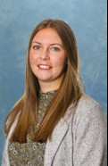
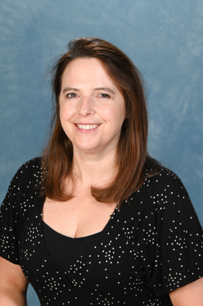
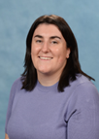
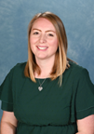
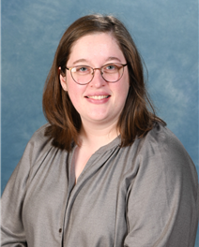
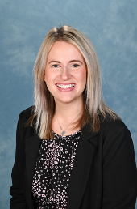
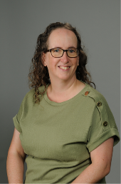
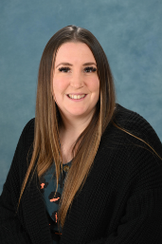
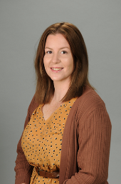
Meet the Year 3 Team…
3EF – Mrs Freeman
Team Leader
3EF – Mrs Brignall
Class Teacher
3RL – Mrs Ransom
Class Teacher
3RL – Mrs Long
Class Teacher
3AM – Miss Marcham
Class Teacher
Learning Support Team…
Mrs Williams
HLTA
Mrs Fishleigh
LSA
Mrs Wilkes
LSA
Miss Beagley
LSA
Notes:
EF

Slide 3
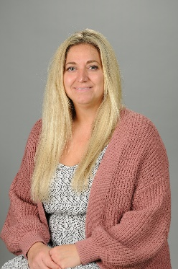
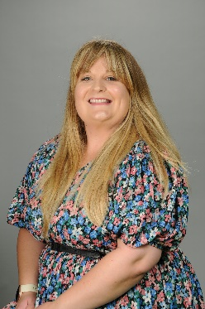
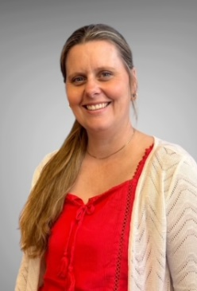
Extended Team…
Miss Parsons
Federation SENCO
Mrs Kirby
FSW
Mrs Barratt
ELSA
Notes:
EF
Mrs Kirby – Parent pages, 1:1 support, parent workshops, signpost to specialist support beyond the school

Slide 4
A few highlights of the year to come…
Spring
Stone Age Creative Day
3RL Radio Show
3EF Class Assembly
Musical Performance
Butser Farm Trip
Summer
Fantastic Finish Learning Exhibition
Local Area Walks
Ancient Egyptian Creative Day
3EF Radio Show
3AM Class Assembly
Autumn
DT Projects
3AM Radio Show
3RL Class Assembly
Christmas Fun
Christmas Production!
Remember to check Miss Redman’s weekly newsletter for upcoming dates and events!
Notes:
LL
Here is an overview of all of the exciting things we will be doing over the course of the year.
Following parent feedback, to support extended curriculum resources, each year we ask for a one off voluntary donation of £10 to cover the ‘luxuries’ of some of our curriculum provision.

Slide 5

Exciting opportunities and responsibilities …
School Councillor
Eco Committee Representatives
Class Monitors
Responsibility Assembly:
9th September 2025
Applications Deadline:
22rd September 2025
Appointments:
26th September 2025
Notes:
LL
There are a range of exciting opportunities for the children this year:

Slide 6
Attendance
The school day starts from 8.30am – into class at 8.40am (precious support time – reading, handwriting, home learning, mop up, pre teach!)
Learning time is maximised 9.00am lesson begins (before if everyone present!)
The Local Authority and Government expects the minimum satisfactory attendance to be at 95%
If absent, inform school (phone or email school.admin NOT ClassDojo!) ASAP but by 9.00am (safeguarding procedures – 3 contacts)
100% termly and annual certificates
90% attendance is the same as having a day off every two weeks.
Having 90% attendance over a all of a child’s time in school is the same as missing a complete year!
Being 15 minutes late for school is the equivalent of missing two weeks of school each year!
Notes:
AM
Attendance is really important for your child’s learning and social development (we have definitely learnt this!) - Appreciate circumstances continue to be challenging and safety will always come first, however, attendance is statutory and important for every child
For the class with highest attendance- they get a star on the chart
Most stars in a term – earn an afternoon in which the class choose a treat.
100% termly certificates will be awarded
Miss Redman has responsibility to monitor and report to parents and governors termly (Ofsted indicator) –particularly important to support progress and well-being!
Expectation is a min of 95% (below is considered persistent absentee).

Slide 7
Home Learning…
Reading – key to learning, expectation of 5 times a week, complete record
Spellings - practise at home using the Spelling Shed website or other if preferred
TTRockStars/Numbots - regular practise will unlock many aspects of our Maths Curriculum!
Summer topic home learning project – Ancient Egyptians
Knowledge Organisers will be uploaded to ClassDojo.
Notes:
AM
We have a number of different home learning requirements in year 3
KO example on next slide

Slide 8
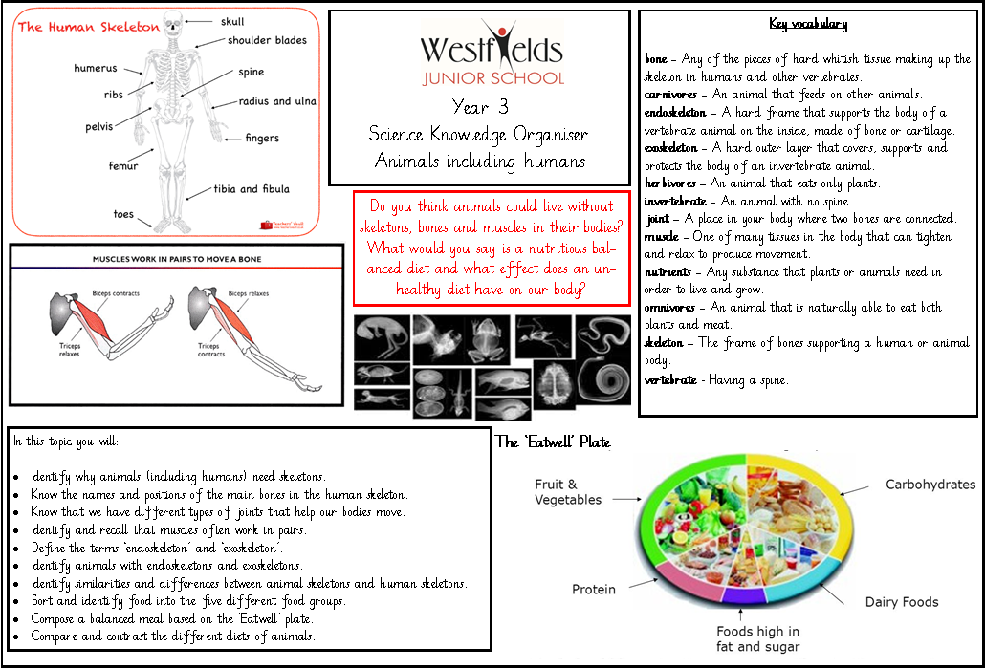
Notes:
AM

Slide 9
Important reminders…
Termly Year Group Newsletters and Topic Webs
Mobile Phones
Uniform
Coats
P.E Kits
Termly Attainment Trackers and Key Targets
Walking Home Agreements
Free School Meals
Annual donation of £10
Healthy snacks and water
Notes:
CR
Today you will receive the year group newsletter and this included important reminders, key information about the term ahead as well as a topic web so that you know our focusses for the term
Mobile phones should not be brought in to school for year 3 – only year 5 and 6.
Uniform – great start. Please continue
Coats – please make sure children have appropriate outerwear
PE kits – Please ensure they are in every Monday.
Attainment – There will be a parents’ evening in November to discuss progress and settling in. You will receive your child’s attainment tracker with key targets in January which will inform you of your child’s attainment against the curriculum as well as what your child is on track to achieve at the end of the academic year. Tracker 2 (after Easter). Reports at the end of the summer term.
Walking home agreements – need to be signed/email before children can leave without a parent. Please think carefully before completing this as the children will have full permission to walk out at the end of the day. Be clear where you are meeting them or where they are walking to.
Free school meals – If you believe you are eligible for FSM, please contact Mrs Pagden on school.admin email address
Annual donation – with a focus on DT and enrichment with creative days, it would be very much appreciated if you contribute towards this
Healthy snacks – fruit and veg only. No nuts.

Slide 10


Open Doors…
Open and honest relationships; parent and school partnership is essential, we share responsibility for your child’s education and well-being
Communication lines (questions and queries) – playground, ClassDojo, email, telephone…
Parent helpers (DBS) – good to have (just in case!)
Join us for Parent Forum/Blue Sky (23.09.25: 2.30pm-3.15pm) – celebration of successes and opportunity to discuss your suggestions and ideas about moving our school forwards
PAWS – all welcome (Welcome Meeting/Parent Forum 23.09.25: 7.00pm- 8.00pm)
Notes:
CR
Support – we are here to support you and the children – happy children are successful learners.
Open door- We have an open door policy at Westfields! If you have any queries or questions or concerns you can either call, email or message on ClassDojo
Parent helpers- We love parent helpers in class eg. reading, day visits and special events if any of you are interested in helping out within school during the afternoons, please let your class teacher know. If you do not have a current DBS check and would like to help we can arrange that before you assist in school.

Slide 11

Any
questions?
Notes:
EF

